Slide 1
Artemix
Interactive Medium-Fi Prototype
Presented by Yutong Zhang, Winnie Chen, Georgia Limcaoco, Kongmeng Her
Remixing the way you art.

Slide 2
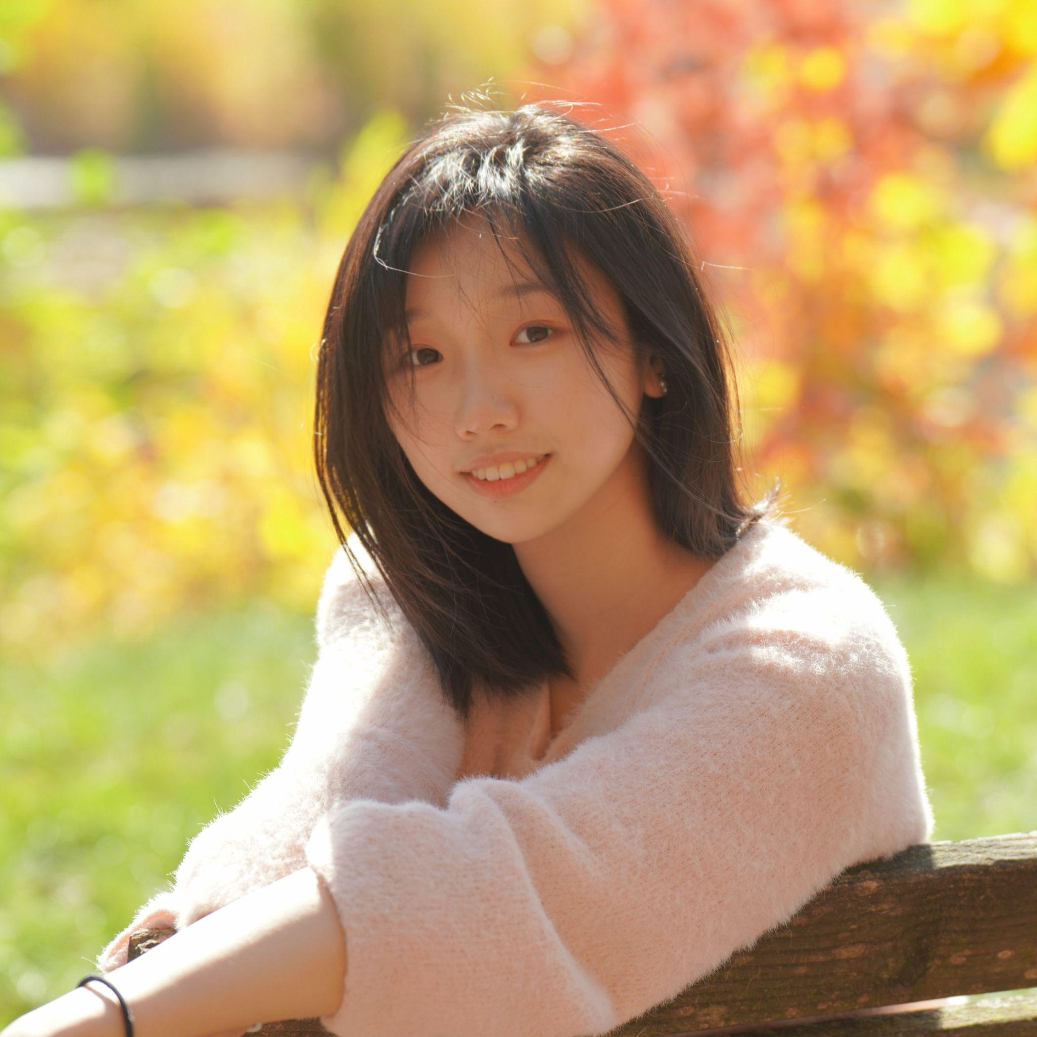

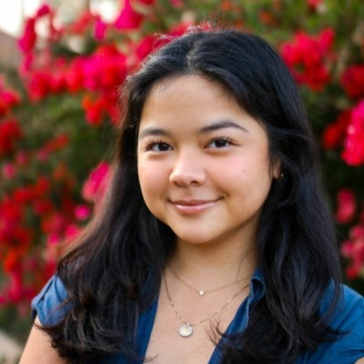
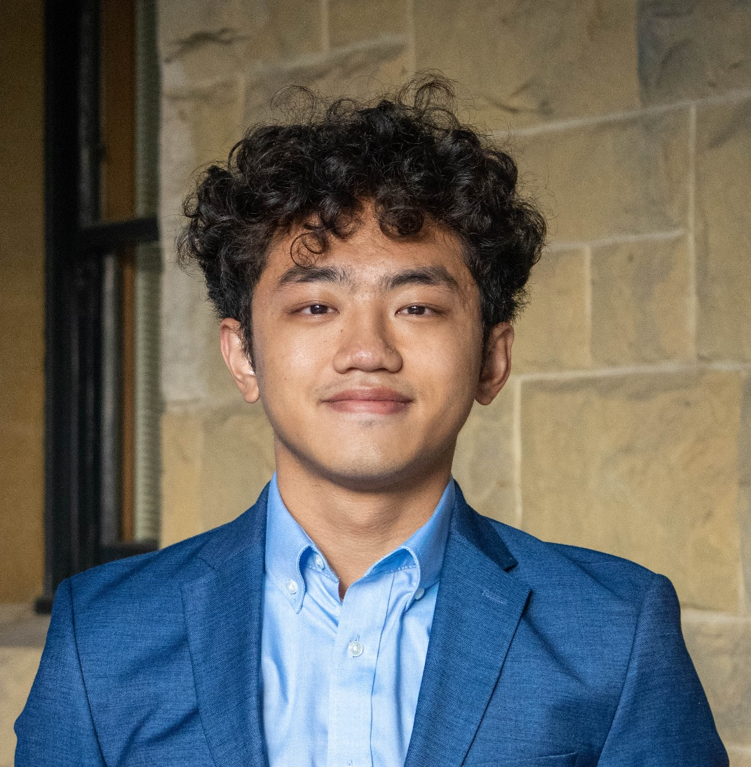
Value Proposition and Team
Artemix
Yutong Zhang
Winnie Chen
Remixing the way you art.
Georgia Limcaoco
Kongmeng Her

Slide 3
Problem & Solution
Problem
We noticed that creatives worked in isolation (writers, graphic designers, etc) and had a lack of a community that could provide supportive and helpful feedback or discussion surrounding their work.
Solution
An app designed specifically for creative professionals and dedicated hobbyists aims to foster genuine and positive connections. By anonymizing artists, it ensures unbiased appreciation of art work, recommending connections only after a user consistently admires a particular artist's contributions.

Slide 4
Table of Contents
01
02
03
04
05
06
Encoding Values
Task Overview
Usability Goals & Key Measurements
Interface Revisions
Med-fi Task Flows
Prototype Implementation

Slide 5
01
Encoding Values

Slide 6
Design values
Intentionality
Flexibility & Autonomy
Intuitiveness
Empower users with full control over their relationship with an artist they connect with, along with diverse options to explore further.
Make art easily accessible and exploratory, ensuring that connections to artists feel instinctive and seamless.
Artists connect only with users who are familiar with and interested in their art.

Slide 7
Value-aligned Features
Intentionality
Flexibility & Autonomy
Intuitiveness
Users are prompted to connect with an artist only after they've consistently shown interest in artworks through "likes", without prior knowledge of who the artist is
- Homepage design should highlight the creative work and clicking on them should lead to a decluttered screen.
- When a user "likes" a piece, they are then shown more posts from that same creator, guiding them smoothly towards an artist recommendation.
Includes features such as chat for direct communication, scheduling tools for potential online and offline meetups, and mutual preferences, allowing users to delve deeper into understanding each other.

Slide 8
Value Tensions
Intentionality
Flexibility & Autonomy
VS.
Enhancing connection quality through restrictions
Empowering users with complete control
Features
User interaction on the app is restricted until they have connected to an artist.
Users can explore countless arts but can't directly search for artists.
Can’t join in comments discussion until they’ve indicated “like”.
Protecting artist anonymity is essential.
These restrictions ensure artists connect based on an interest in arts, aligning with our main purpose.

Slide 9
02
Task Overview

Slide 10
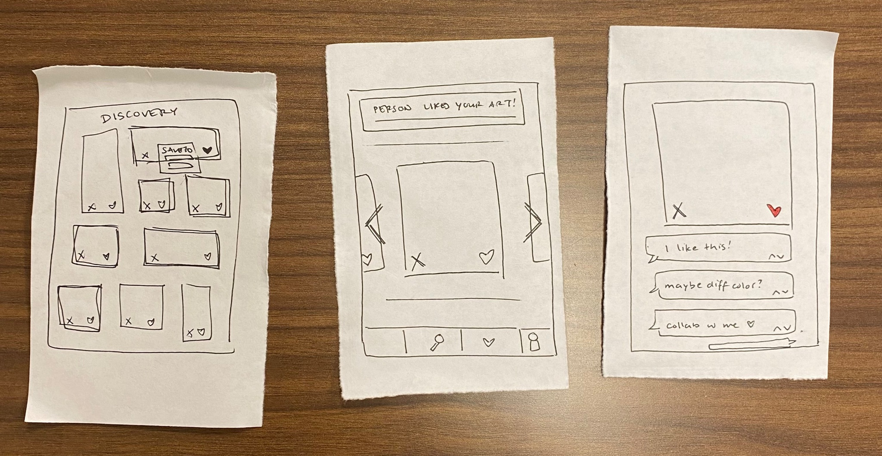

Simple Task: Liking/Disliking Arts
Proposed Change:
Exploring and liking art to express personal interest.

Slide 11
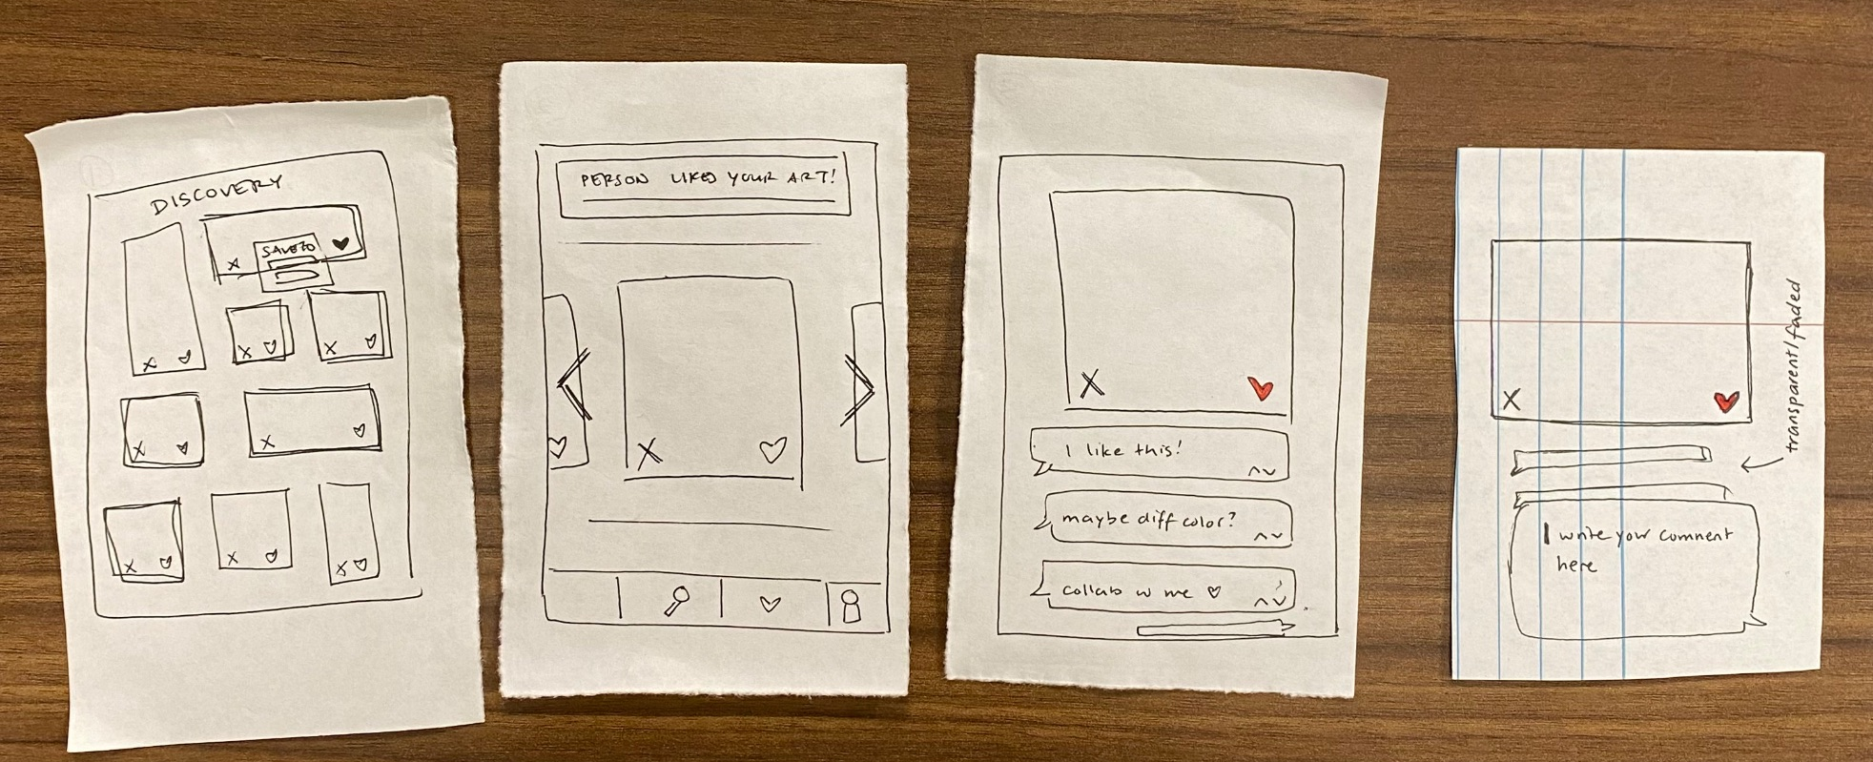
Moderate Task: Engaging in comments
Proposed Change:
Joining comment discussions on a particular piece of art after the user has shown their appreciation by "liking" it.

Slide 12
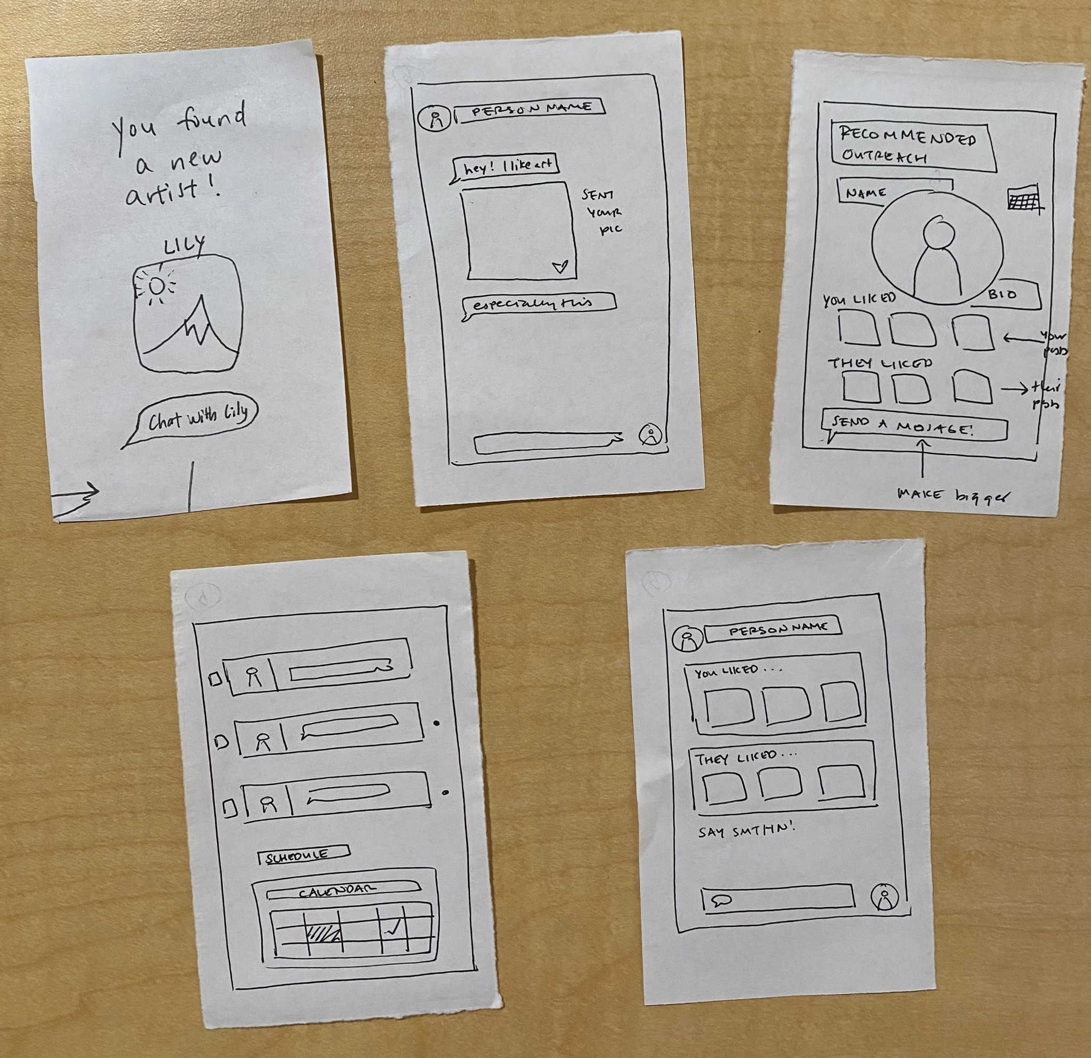
Complex Task: Connecting and engaging with artists
Utilize…
Scheduling
Mutual Preferences
Chat

Slide 13
03
Usability Goals & Key Measurements

Slide 14
Usability Goals & key measurements
Goal 1: Learnable
Goal 2: Discoverable
Learnable influences the desire to engage with art sharing and discovering
Discoverable correlates with the willingness to interact with artists.
Count the number of connection-related features that participants completed without facilitator intervention.
Count the number of subtasks finished before the facilitator intervened.

Slide 15
Progress Towards Usability Goals
Goal 1: Learnable
Goal 2: Discoverable
Decluttering the home screen
Artwork should be the only thing users see on the home screen (besides the navigation bar)
Softly-designed clickables to create an inviting feeling for users.
Increase clarity on icons to avoid ambiguity.
Spreading out the full functionality of complex interactions to create a sense of progression that feels natural.
More options for users (ie clicking away, ability to “save for later”, etc)

Slide 16
04
Interface Revisions

Slide 17
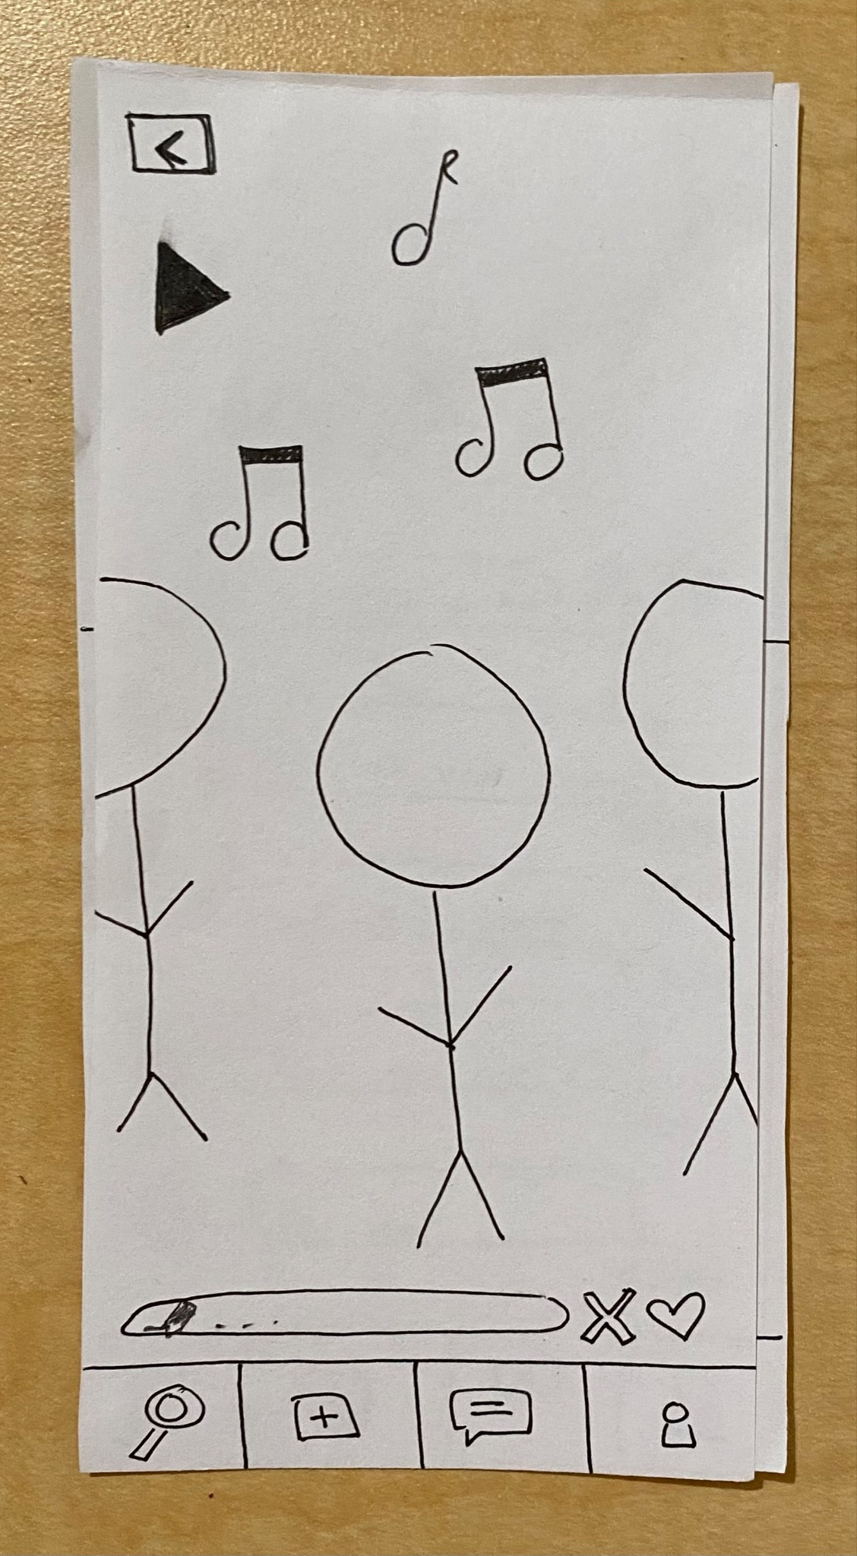
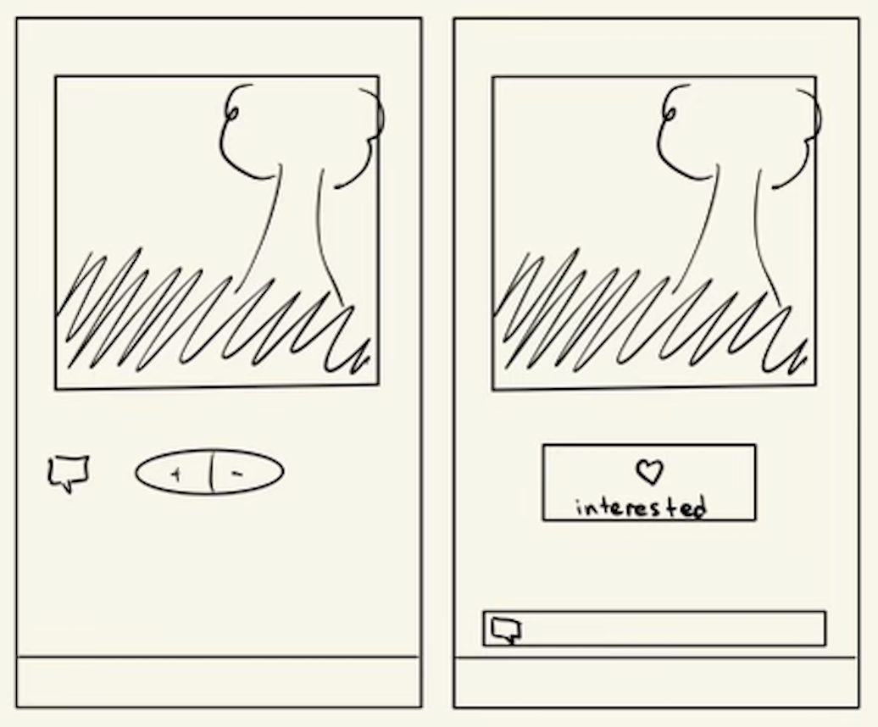
Major change #1 - Likes & Dislikes
Different design considerations
Final decision

Slide 18
Major change #1 - Likes & Dislikes
Reference:
Participants feared the ❌ "not interested" button would alert the creator.
Strategy:
We heavily debated about keeping a dislike button. Ultimately, we decided to make do without it as we did not like the implications of pressing a dislike. From Lo-Fi testing, our results also discouraged the usage of a dislike button.
Notes:
While it serves as the main driving force for the recommendation process, we also intend for likes to be a personal and intimate feature for each user. The focus isn’t on what others have liked (thus likes aren’t shown), or what a user doesn’t like, but genuinely what they like and are interested in. This choice also declutters the screen, reducing the amount of tasks a user completes on each post they see, encouraging the exploration of more posts.

Slide 19
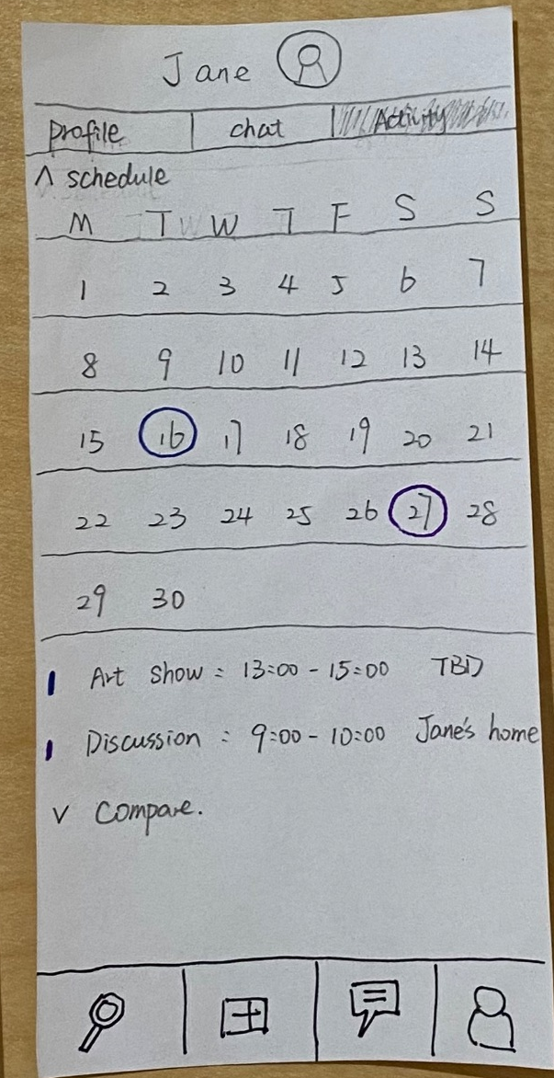
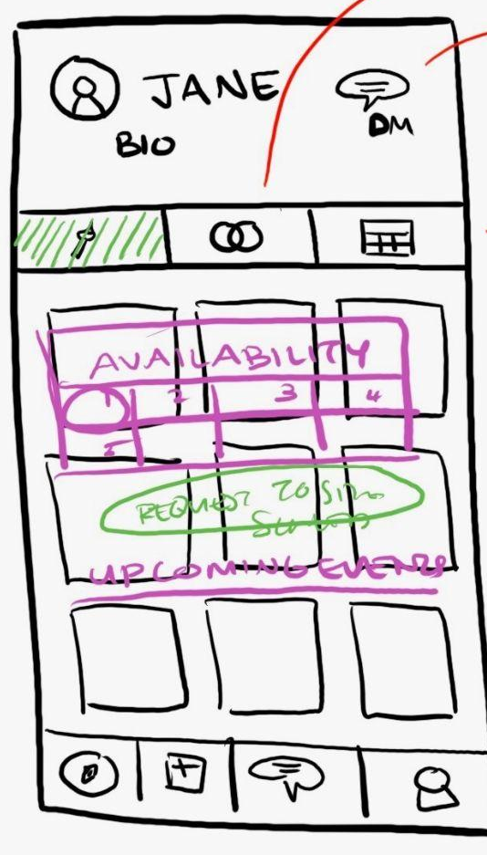
Major change #2 - Scheduling Change
Reference:
Scheduling page purpose and functionality was unclear to all participants
Strategy: Instead of just a calendar with circled dates when there are events for a mutual artist, we revamped the scheduling page to allow users to see mutual artists’ availability and send a request for a meeting. This addresses questions in our low-fi prototype testing about how to actually schedule time with a mutual artist and moves toward the usability goal of being discoverable as users are brought through a natural progression to interact & schedule meetings with mutual artists.

Slide 20
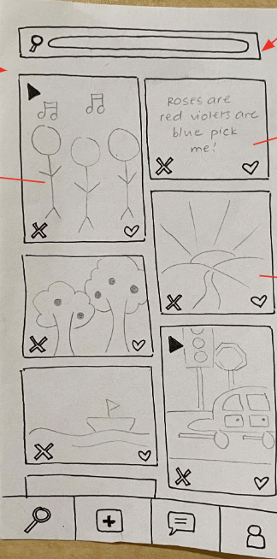
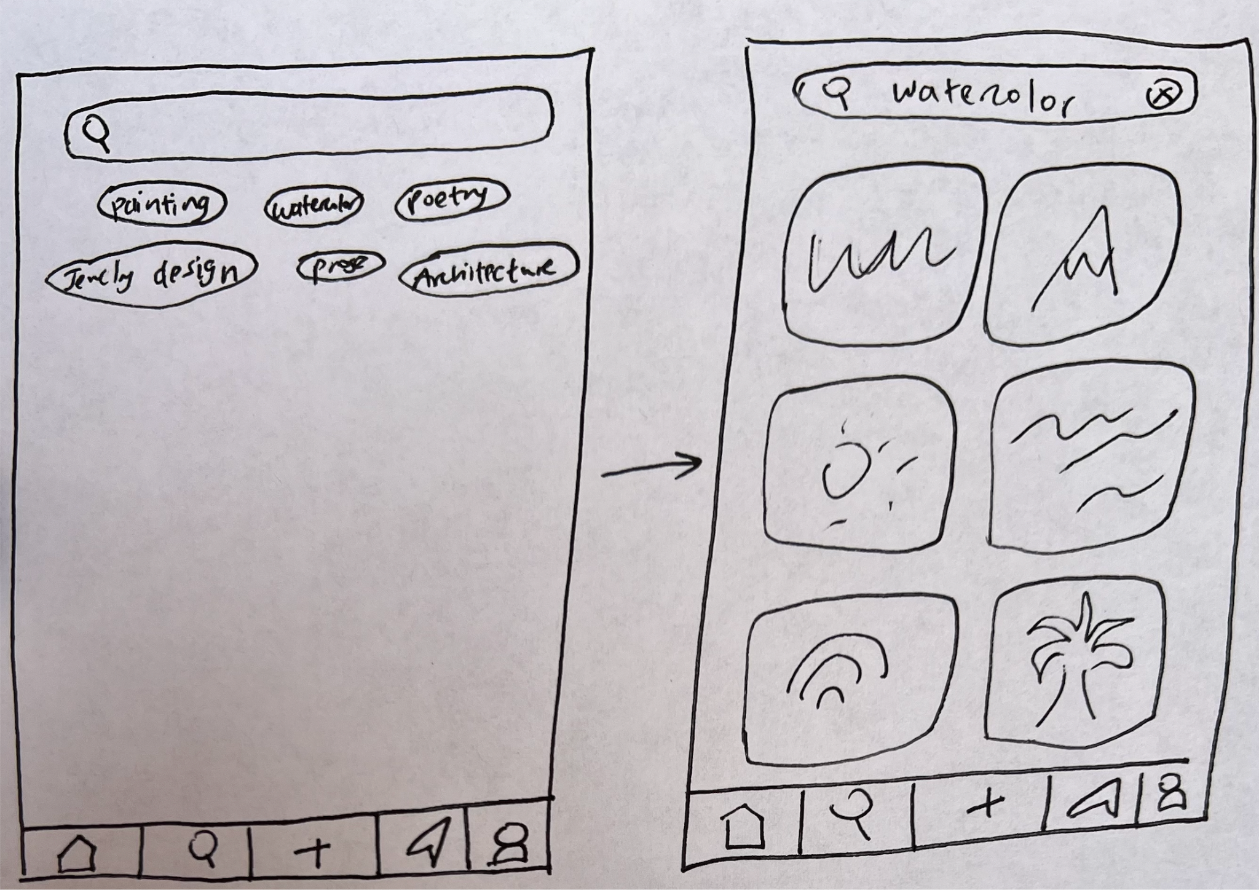
Major change #3 - Search Page
Strategy:
Rather than just have a search bar on the discover page, we decided to implement a dedicated search page. As mentioned by a participant in our low-fi testing, this is more intuitive for users who are familiar with other social media apps such as Instagram and Pinterest. This moves us toward our usability goal of being learnable, allowing users to easily understand where/how to search.

Slide 21
05
Med-Fi Prototype Task Flows

Slide 22
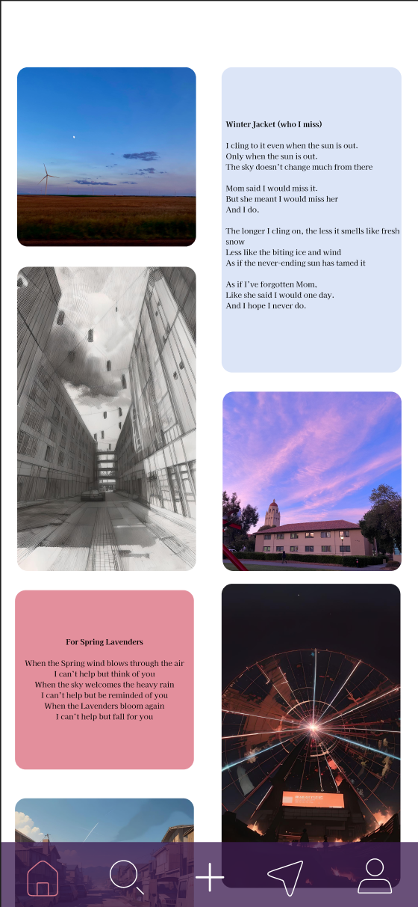
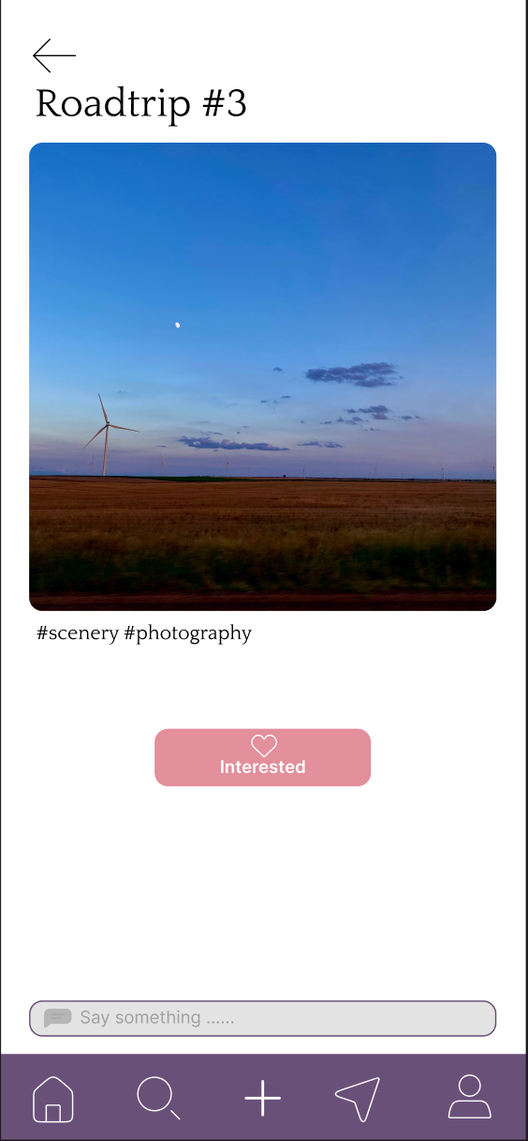
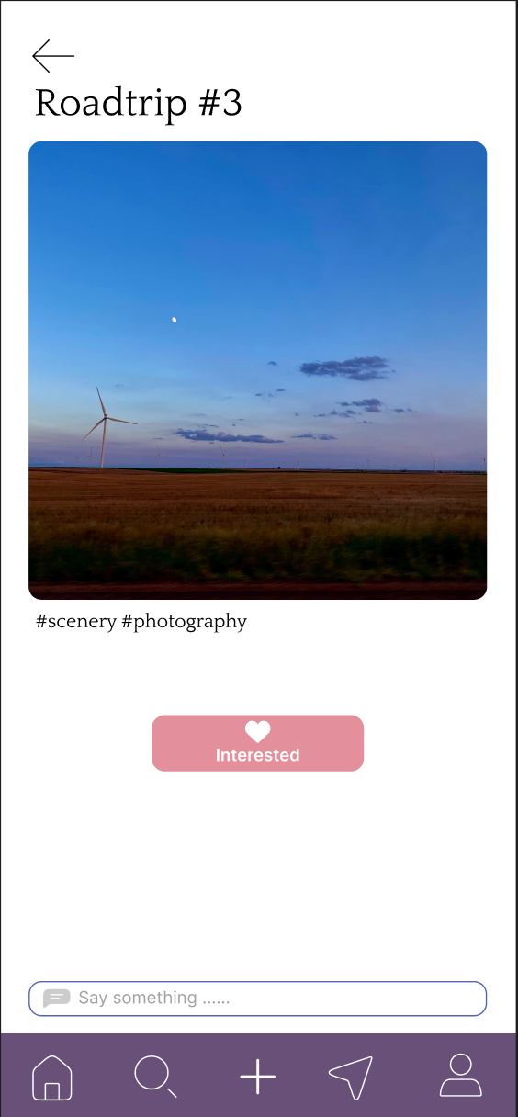
Simple Task
Explore art from Home Page
Click on the “interested” button to indicate a like
The heart lights up to indicate completion of the task

Slide 23
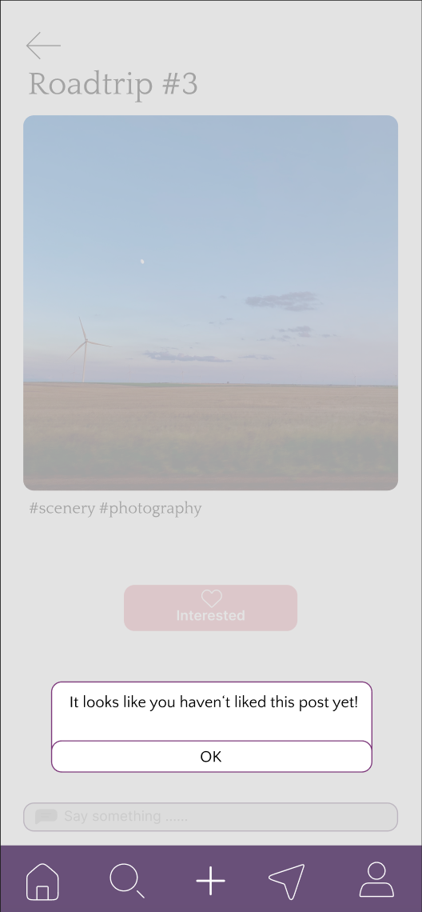
Moderate Task
Attempts at accessing the comments without liking will lead to a pop-up that intuitively explains the functionality: engaging in comments of art you’ve actually liked.
Once the simple task has been completed, the comment bar also changes in look

Slide 24
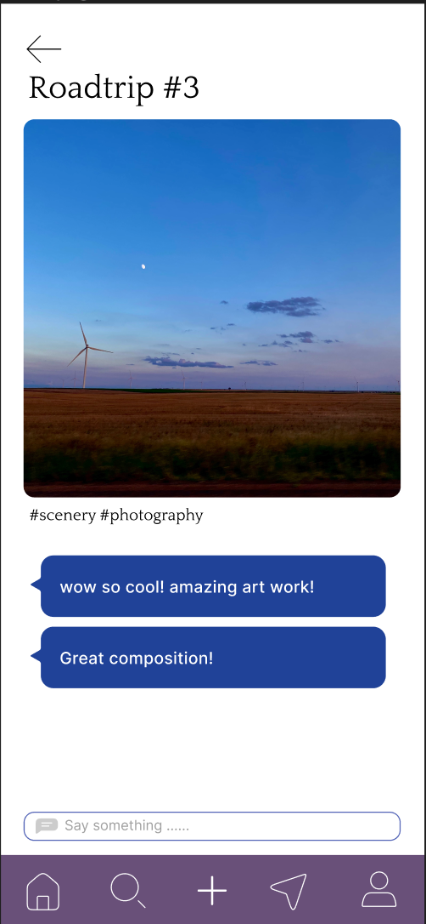
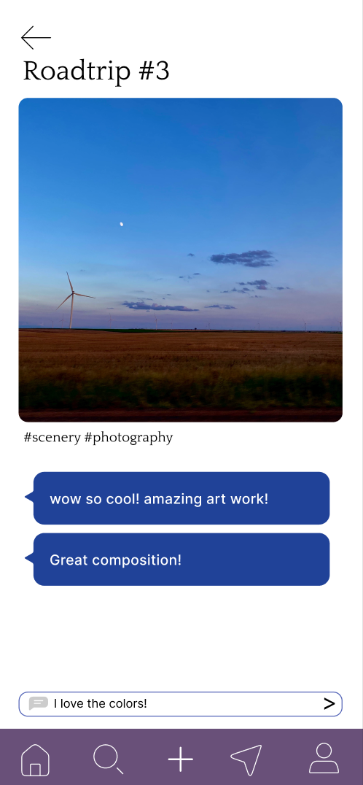
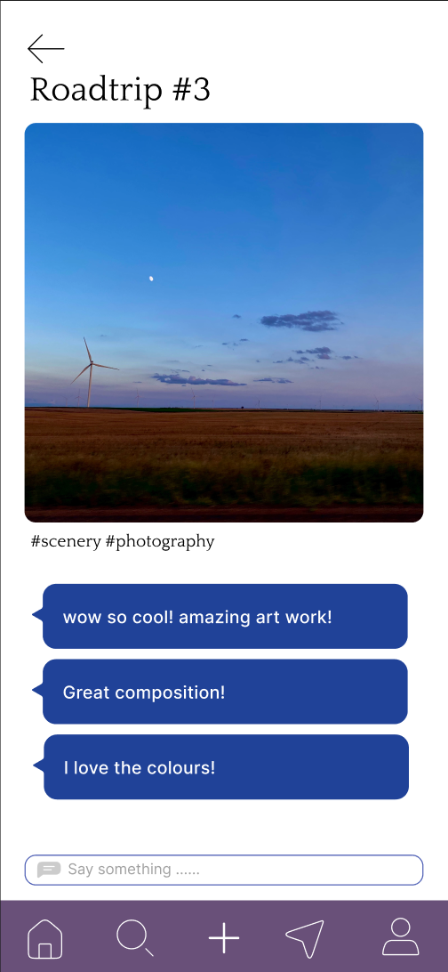
Moderate Task Cont.
Engage in great discussion in an anonymous comment section
Notes:
For the sake of the med-fi, commenting has a wizard of oz type functionality to simulate the experience as their lacks a backend of proper comments. There’s also an assumption that the comments will generally be positive because of anonymity of users, and having restricted the functionality to users who indicate a like for the post.

Slide 25
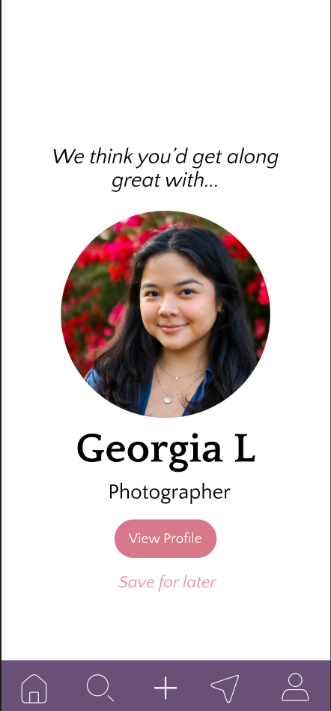
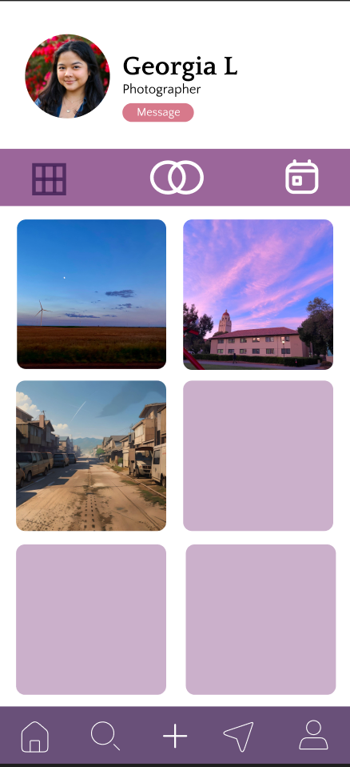
Complex Task
Example page of a user profile. Main functionality includes viewing their posts, mutual preferences, and a scheduling tab.
An artist recommendation page takes up the whole screen, with two available options: viewing the profile or saving it for later.
Notes:
*For clarity, we were heavily inspired by Instagram for the posts icon.

Slide 26
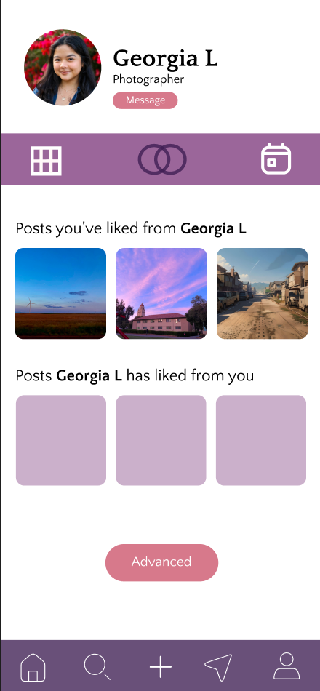
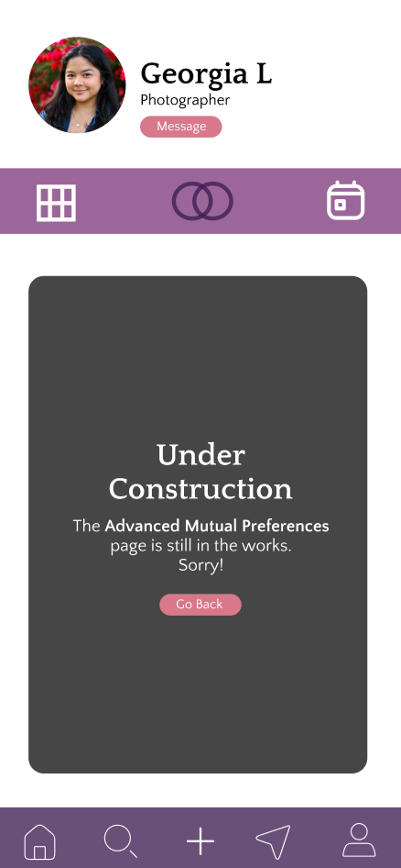
Complex Task - Mutual Preferences
More robust details and functionality coming soon.
View all the posts you two have liked from each other.
Notes:
We’re anticipating the possibility of seeing other information with regards to your connections (preferences you each have selected, most liked posts, recommendations for artwork for both users to see, etc). We’re still considering the privacy concerns regarding this and are working on the full extent of what should be shared within this page.

Slide 27
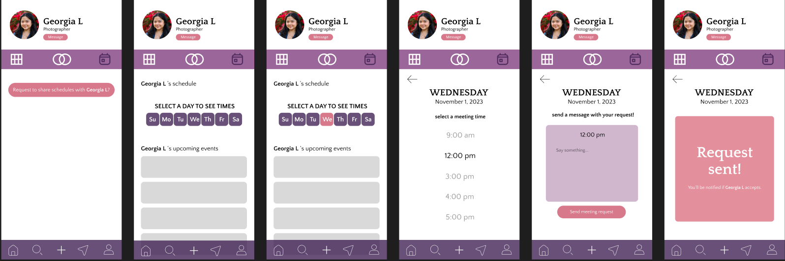
Complex Task - Scheduling
Request Button for privacy concerns.
Week-by-Week scheduling availability. (Inspired by when2meet)
Option to send a personalized note.
Notes:
Scheduling provides a lot of unique functionality for the users! It can be used as a first meetup type of activity, or something more casual like meeting up to attend an art show together. It can even be for something super serious such as a meeting to discuss a potential collaborative piece! The flexibility in its ceiling allows for numerous types of interactions and relationships to form.

Slide 28
06
Prototype Implementation

Slide 29
Design Tools
We utilized Figma to build our med-fi prototype.
Pros:
Many tools and features to mimic the usage of an app
Easy accessibility and support for remote collaboration
Lots of support and documentation for ease of use
Cons:
Flows are linear, difficult for dynamic interactions
No backend support for saving changes made
Notes:
We utilized Figma to build our med-fi prototype. With its plethora of resources, features, and support, we were able to simulate the functionality of our app with clear design goals. The app is intended to for all mobile devices, but for the purposes of the prototype, it's specifically simulated on an iPhone template. All icons were either in-house designed or taken from Figma’s community free pack of icons.

Slide 30
Limitations
Limited functionality
  No endless scrolling, messages button from the navigation is disabled, only 1 artist recommendation
Multiple screens lead to “under construction” page where more granular details would be found, but not completed in this prototype
  settings, advanced changes, etc
  Continued details on art posts
Notes:
In this prototype, we were unable to create a fully fledged home page with endless scrolling of new posts/artwork. While our goal is centered on connecting multiple artists, this prototype only works with one recommendation. The recommendation system itself also requires work as currently it lacks robustness when recommending connections. The search functionality currently doesn’t support filtering, which we intend on expanding upon in the future. We also had to disable the functionality of one of our buttons to keep our original premise.

Slide 31
Wizard of Oz
Artist recommendation
The process is hardcoded, clicking like on one of the last posts leads to the pop-up
All data is faked
Upload Process
Lots of actual steps are skipped for the sake of the prototype
Search
Only 1 possible search is able to be completed
Notes:
The app magically fills in the user registration with a fake profile for ease in use. The artist recommendation is also done arbitrarily given the limited artwork shown and lack of other real users/posts. Comments and searches made are also done for the sake of the limited data on the prototype. The upload functionality also magically works for the sake of the prototype.

Slide 32
Hard-Coded Items
Nearly all content on the prototype is hard-coded.
All artwork
  Personally sourced or from the Internet/AI tools
Comments
Artist recommendation process
  See slide 35
Notes:
Nearly all content on the app is hard-coded. All artwork is either personally sourced, found online, and/or altered by AI tools for the sake of variety. The comments seen are also hard-coded as the experience we’re trying to create for testing relies on a pre-existing community and interactions on the app. Lastly, the artist recommendation profile is also hard-coded with a fake bio and posts as prototypes generally require some level of pre-existing data for the sake of testing.

Slide 33
Thanks!

Slide 34
Appendix
Notes:
Consent forms found in team drive, assignment 5 folder

Slide 35
Prototype Link
https://www.figma.com/proto/IpITNfMCz8ICpNXF7mpr22/Artemix?type=design&node-id=232-518&t=XeDtYQs2jeDO6Ex1-0&scaling=scale-down&page-id=0%3A1&starting-point-node-id=232%3A518&show-proto-sidebar=1

Slide 36
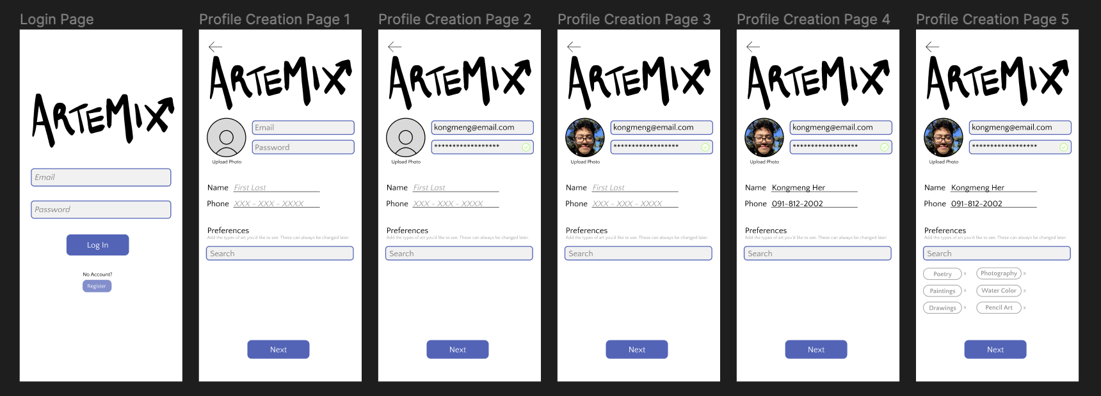
Onboarding Flow

Slide 37
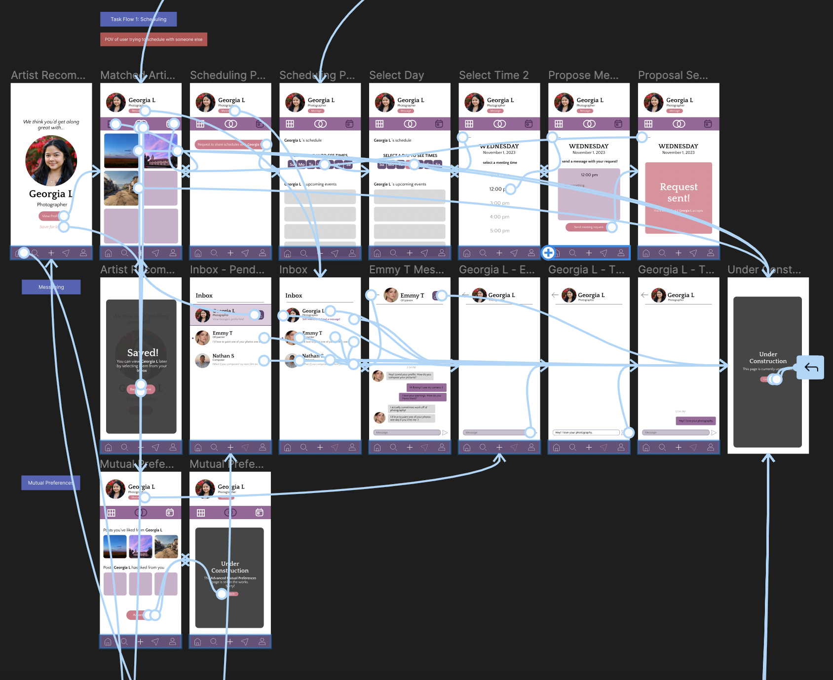
Matched Artist Task Flows
Includes:
Matching
Profile Viewing
Scheduling
Messaging

Slide 38
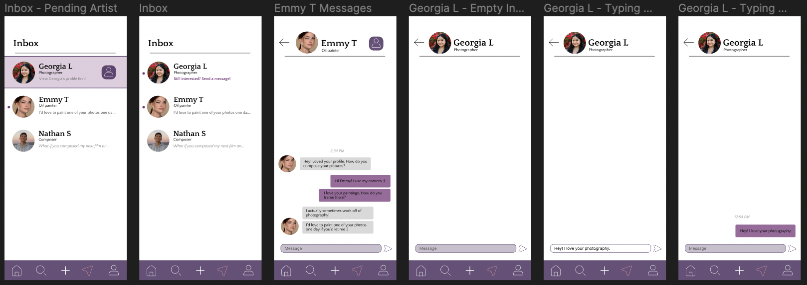
Inbox/Messaging Task Flow

Slide 39
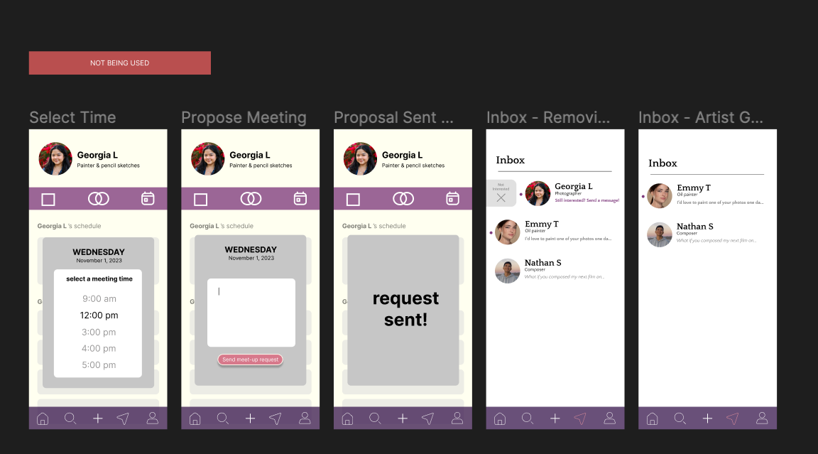
Not Currently Being Used
*Can potentially be used in the future*

Slide 40
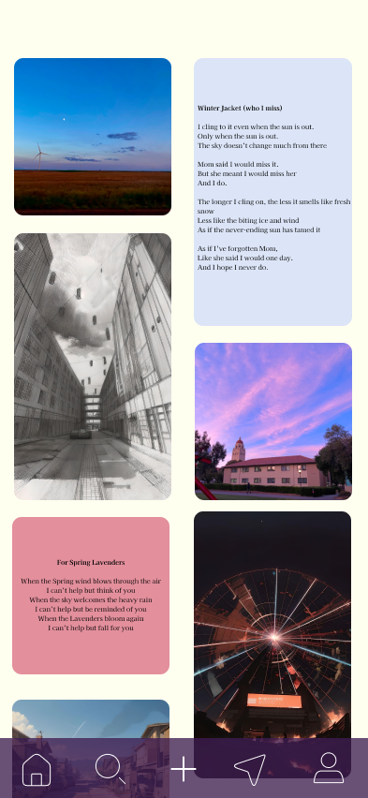
Home Page Layout

